Slide 1

KP-IT Board AI (ML/DL) Certification
Trainer: Fawad Bahadur
2

Slide 2
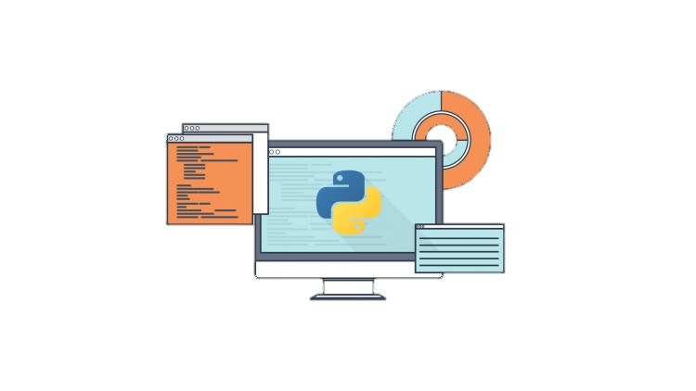

Introduction to Python
High-level, interpreted, general-purpose programming language.
Known for its clear syntax, readability, and simplicity.
What Is Python?
Python is a high-level, interpreted, general-purpose programming language.
Known for its clear syntax, readability, and simplicity.
Used by beginners and experts alike due to its versatility.
Why Learn Python?
Beginner-friendly yet powerful for complex applications.
Widely adopted by Google, NASA, Netflix, and more.
Trainer: Fawad Bahadur Marwat

Slide 3


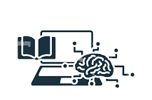
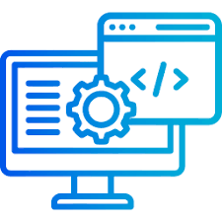

Conti…
High-level, interpreted, general-purpose programming language.
Known for its clear syntax, readability, and simplicity.
Key Features
Easy to Learn & Write – Minimalistic syntax, resembles English.
Rich Standard Library – Pre-built modules for faster develop
Strong Community Support – Active forums, tutorials, and open-source contributions.ent.
Versatile – Used in:
Web Development (Django, Flask)
Data Science & AI (Pandas, TensorFlow)
Automation & Scripting
Game Development (Pygame)
Trainer: Fawad Bahadur Marwat

Slide 4

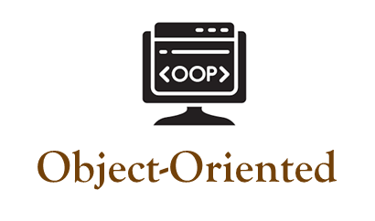
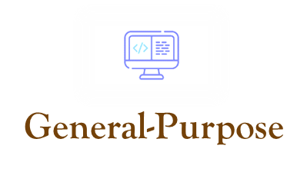
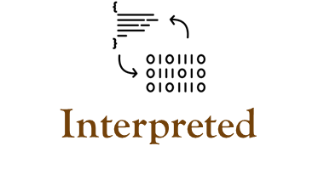

Key characteristics
Simple, abstracted coding
Classes, objects support
Versatile, multi-domain use
Runs without compilation
Trainer: Fawad Bahadur Marwat

Slide 5
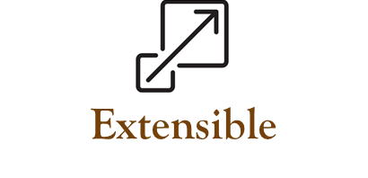

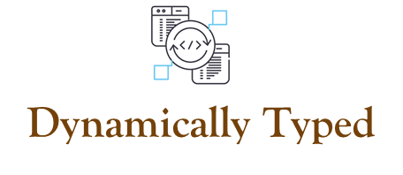

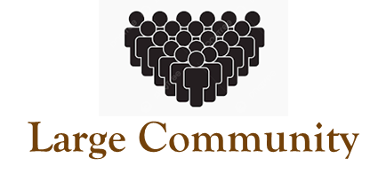
Conti…
Integrates external code
Rich libraries, tools
Flexible variable types
Runs on all OS
Active, supportive network
Trainer: Fawad Bahadur Marwat

Slide 6

Python Programming
Applications
Web Development
Data Science
Data Analytics
Machine Learning & AI
Automation and Scripting
Software Development and Prototyping
Desktop GUI applications
Scientific and Numeric Computing
Game Development
Education and Research
Trainer: Fawad Bahadur Marwat

Slide 7

Download & Install Python
1
2
Download Python
Run the Installer
Visit python.org/downloads
Choose the latest stable version (e.g., Python 3.12).
Windows/macOS: Double-click the downloaded .exe (Windows) or .pkg (macOS).
3
4
Setup Options (Windows/macOS)
Verify Installation
Check "Add Python to PATH" (Critical for command-line use).
Optional: Install pip (Python’s package manager).
Open Command Prompt/Terminal and type:
python --version
Trainer: Fawad Bahadur Marwat

Slide 8

Install Anaconda for Python
Why Anaconda?
Includes Python, Jupyter Notebook, and key libraries.
Simplifies setup for immediate coding.
1. Download Anaconda
3. Key Installation Options
Visit anaconda.com/download
Choose Python 3.x for your OS (Windows/macOS).
Add Anaconda to PATH (Recommended ‘easy CLI access’).
Register Anaconda as default Python (Optional but useful).
2. Run the Installer
4. Verify Installation
Windows: Double-click .exe → Follow prompts.
macOS: Open .pkg → Drag to Applications.
Open Command Prompt/Terminal, run:
conda --version
Trainer: Fawad Bahadur Marwat

Slide 9
Set Up Jupyter Notebook
1
2
Open Anaconda Navigator
Start Jupyter Notebook
Launch from your system after installation.
In Navigator, click the Jupyter Notebook icon.
3
4
Create a New Notebook
Start Coding
Opens in your web browser.
Click New > Python 3 in top-right.
Write Python code in notebook cells.
Press Shift + Enter to execute.
Trainer: Fawad Bahadur Marwat

Slide 10
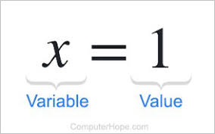

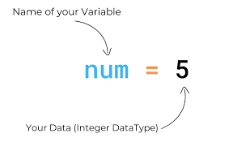

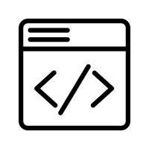
Variables in Python
What is a Variable?
A named container to store data in memory.
Holds values that can be changed during program execution.
Key Rules
Names are case-sensitive (x ≠ X).
Can include letters, digits, _ (no spaces).
Cannot start with a digit.
Avoid Python keywords (if, for, etc.).
Syntax
Example
variable_name = value
age = 25
name = "Alice"
Trainer: Fawad Bahadur Marwat

Slide 11
Data Types
What is Data type?
Building Blocks of Python Programs
1. Numeric Types
Int, Float, Complex
2. Sequence Types
Str, list, tuple
3. Mapping Types
dict
4. Set Types
Set
5. Boolean Types
bool
6. None Types
None
Dict
int
str
bool
list
tuple
float
Trainer: Fawad Bahadur Marwat

Slide 12

Integers in Python
What is a Integers?
Syntax
A whole number (positive, negative, or zero) without decimals.
Used for counting, indexing, and mathematical operations.
variable_name = integer_value
Integers
Example
age = 30
temperature = -10
count = 0
Key Properties
Immutable: Cannot be changed after creation
(a new object is created on modification).
Unlimited Size: Python handles large numbers seamlessly.
Trainer: Fawad Bahadur Marwat

Slide 13
Floating-Point Numbers (Floats) in Python
What is a Floats?
Syntax
Represents real numbers (with decimal points or scientific notation).
Used for measurements, scientific calculations, and fractional values.
variable_name = float_value
Float
Example
pi = 3.14159
temperature = -12.5
scientific_notation = 2.5e3 # 2500.0
Key Properties
Precision: Limited by hardware (64-bit double-precision).
Immutable: Like integers, floats are immutable objects.
Trainer: Fawad Bahadur Marwat

Slide 14
Strings in Python
What is a String?
Syntax
A sequence of characters enclosed in quotes (' ' or " ").
Used to represent text data in Python.
string_name = "text" # or 'text'
String
Key Properties
Example
Immutable: Cannot be changed after creation.
Indexed: Access characters using indices (starts at 0).
Iterable: Can loop through characters.
name = "Alice"
greeting = 'Hello, World!'
multiline = """This is a
multi-line string"""
Trainer: Fawad Bahadur Marwat

Slide 15

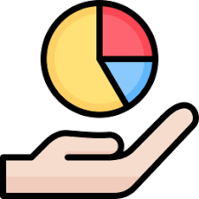
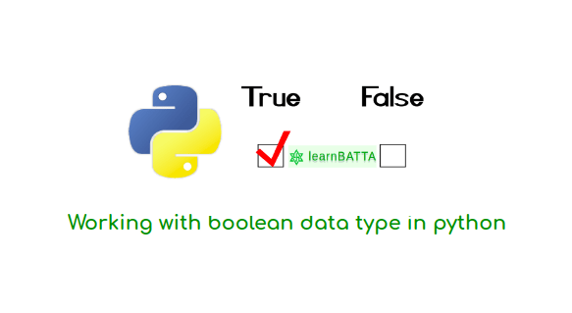
Boolean (bool) in Python
Definition
Represent True or False values.
Example
is_logged_in = True
if is_logged_in:
print("User is logged in")
# Output: User is logged in
Key Uses:
Control flow in if and while statements.
Result of logical operations (e.g., 5 > 3 → True).
Represent states (e.g., on/off, open/closed).
Bool
Conversions:
bool(0) → False,
bool(1) → True.
Trainer: Fawad Bahadur Marwat

Slide 16
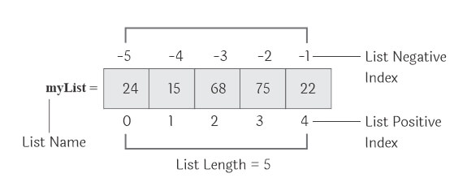
List in Python
Definition
Ordered, mutable collections of items.
Key Features
Can store mixed data types (e.g., integers, strings, lists).
Indexed from 0.
Supports operations: .append(), .remove(), .sort().
Use Cases
Store sequences (e.g., names, numbers, objects).
Example
fruits = ["apple", "banana", "cherry"]
fruits.append("orange")
print(fruits)
# Output: ['apple', 'banana', 'cherry', 'orange']
LIST
Trainer: Fawad Bahadur Marwat

Slide 17
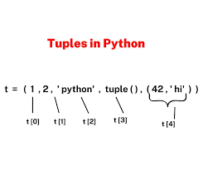
Tuple in Python
Definition
Ordered, immutable collections of items.
Key Features
Values cannot be changed after creation.
Indexed from 0, like lists.
Can store mixed data types (e.g., integers, strings, tuples).
Use Cases
Fixed data sets (e.g., coordinates, color values).
Unpacking: x, y = (10, 20).
Example
coordinates = (34.0522, -118.2437)
print(coordinates[0]) # Output: 34.0522
Tuple
Trainer: Fawad Bahadur Marwat

Slide 18
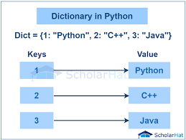
Dictionary in Python
Definition
Stores data in key-value pairs for fast lookups.
Keys: Unique, immutable (e.g., strings, numbers, tuples).
Values: Any data type, mutable.
Use Cases: Structured data (e.g., user profiles, settings, JSON).
Example
student = {"name": "Alice", "age": 22}
print(student["name"]) # Output: Alice
Dict
Key Operations
Add: dict['key'] = value
Remove: del dict['key']
Advantage: Fast key-based access via hashing.
Trainer: Fawad Bahadur Marwat

Slide 19
Set in Python
Definition
Stores unique, unordered elements..
Keys: Unique, immutable (e.g., strings, numbers, tuples).
Values: Elements must be immutable (e.g., strings, numbers, tuples).
Use Cases:
Membership testing, removing duplicates, mathematical set operations (union, intersection, difference).
Example
numbers = {1, 2, 3, 3, 4}
print(numbers)
# Output: {1, 2, 3, 4} (order may vary)
print(2 in numbers)
# Output: True
Set
Key Operations
Add: set.add(element)
Remove: set.remove(element)
Advantage: Fast membership testing via hashing; automatic duplicate removal.
Trainer: Fawad Bahadur Marwat

Slide 20
Comparison of Mutability and Use Case
Data Type | Example | Mutable | Use Case
Int | x = 5 | - | Whole numbers
Float | y = 3.24 | - | Decimals
Str | s = ‘text’ | ❌ | Text
Bool | Flag = True | - | True/False
List | [1,2,3] | ✅ | Modifiable collection
Tuple | (1,2) | ❌ | Fixed Collection
Dict | {“key” : “value” | ✅ | Key-Value Pairs
Set | {1,2,3} | ✅ | Unique elements
Trainer: Fawad Bahadur Marwat

